Slide 1

ECEN 361
Real-Time and Embedded Systems
IOT – Internet of Things
Communications

Slide 2
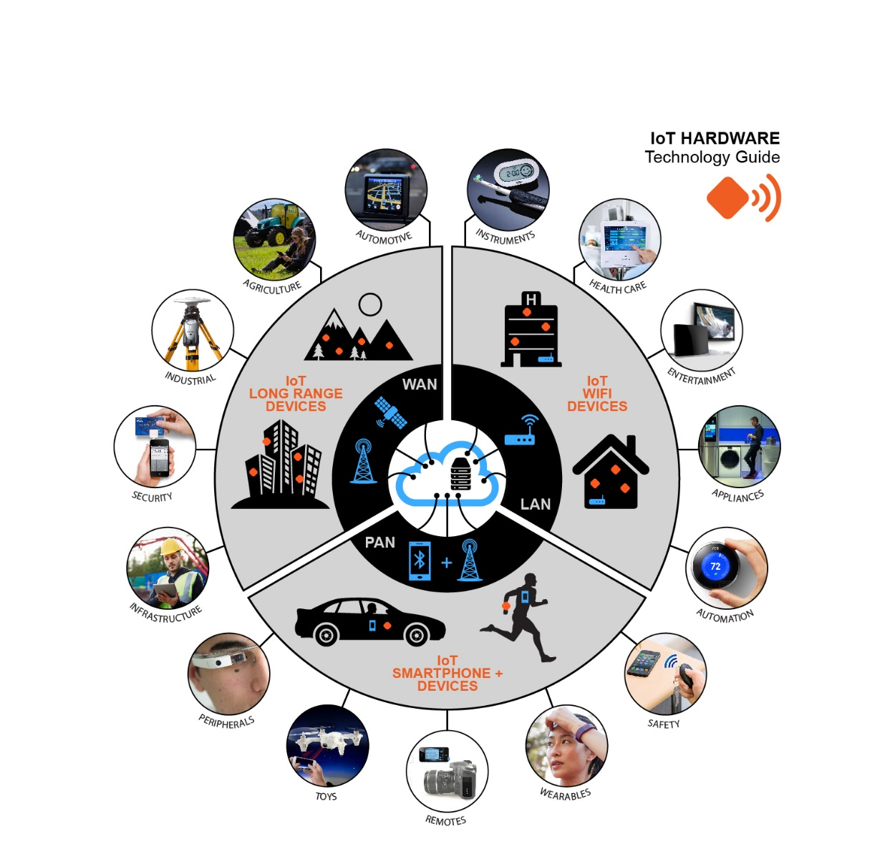
IOT
Internet of Things
Devices that are always available and always connected

Slide 3
IOT
Internet of Things
Devices that are always available and always connected
Power
Communications
Information

Slide 4
IOT - Communications
Internet of Things
Devices that are always available and always connected
Two ways to connect:
Wired
Wireless

Slide 5
IOT - Communications
Two ways to connect:
Wired
Wireless
Many networks use standard LAN
Some use RS-232 or other low speed serial
Some auto/manufacturing applications use CANBUS.

Slide 6
What is CANBUS?
CANBUS or CAN bus – Controller Area Network bus
An automotive serial bus system developed to satisfy
the following requirements:
Network multiple microcontrollers with 1 pair of wires.
Allow microcontrollers communicate with each other.
High speed, real-time communication.
Provide noise immunity in an electrically noisy environment.
Low cost

Slide 7
Who uses CANBUS?
Designed specifically for automotive applications
Today - industrial automation / medical equipment

Slide 8
CANBUS History
First idea - The idea of CAN was first conceived by engineers at Robert Bosch Gmbh in Germany in the early 1980s.
Early focus - develop a communication system between a number of ECUs (electronic control units).
New standard - none of the communication protocols at that time met the specific requirements for speed and reliability so the engineers developed their own standard.

Slide 9
CANBUS Timeline
1983 : First CANBUS project at Bosch
1986 : CAN protocol introduced
1987 : First CAN controller chips sold
1991 : CAN 2.0A specification published
1992 : Mercedes-Benz used CAN network
1993 : ISO 11898 standard
1995 : ISO 11898 amendment
Present : The majority of vehicles use CAN bus.

Slide 10
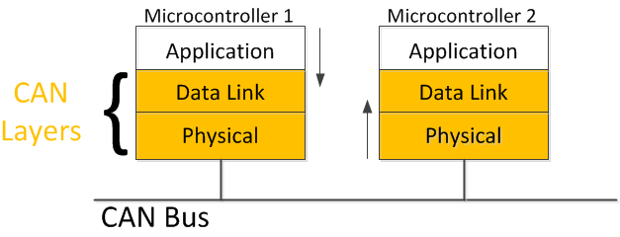
CANBUS and the OSI Model
CAN is a closed network
– no need for security, sessions or logins.
- no user interface requirements.
Physical and Data Link layers in silicon.

Slide 11
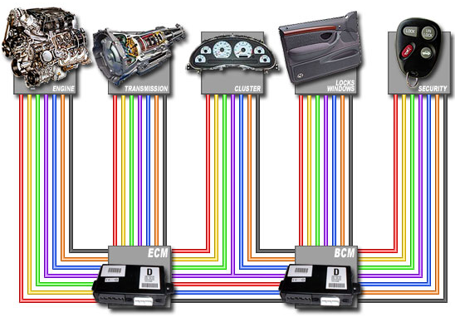
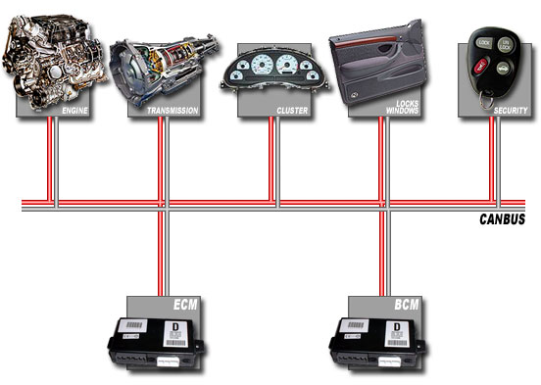
CANBUS Physical Layer
Physical medium – two wires terminated at both ends by resistors.
Differential signal - better noise immunity.
Benefits:
Reduced weight, Reduced cost
Fewer wires = Increased reliability
Conventional multi-wire looms
CAN bus network
vs.
http://canbuskit.com/what.php

Slide 12
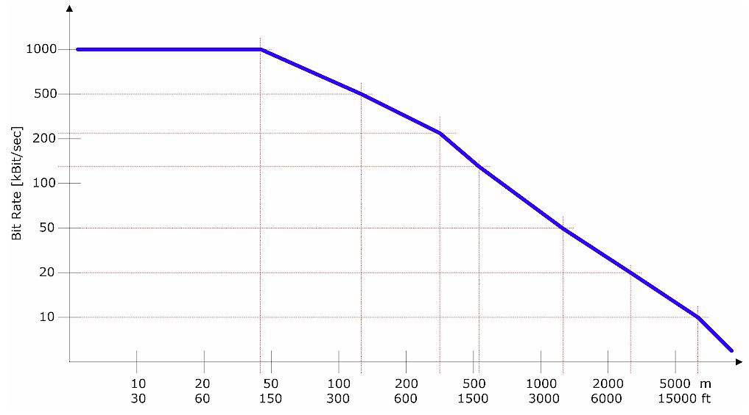
Transmission Characteristics
Up to 1 Mbit/sec.
Common baud rates: 1 MHz, 500 KHz and 125 KHz
All nodes – same baud rate
Max length:120’ to 15000’ (rate dependent)
© esd electronics, Inc. • 525 Bernardston Road • Greenfield, MA 01301

Slide 13
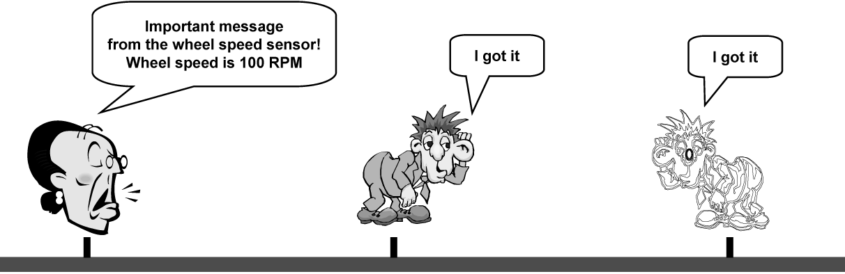
Message Oriented Transmission Protocol
Each node – receiver & transmitter
A sender of information transmits to all devices on the bus
All nodes read message, then decide if it is relevant to them
All nodes verify reception was error-free
All nodes acknowledge reception
CAN bus
© 2005 Microchip Technology Incorporated. All Rights Reserved.

Slide 14
IOT - Communications
Two ways to connect:
Wired
Wireless
Lots of choices:
915 MHz dedicated Link
Bluetooth
WLAN
Zigbee

Slide 15
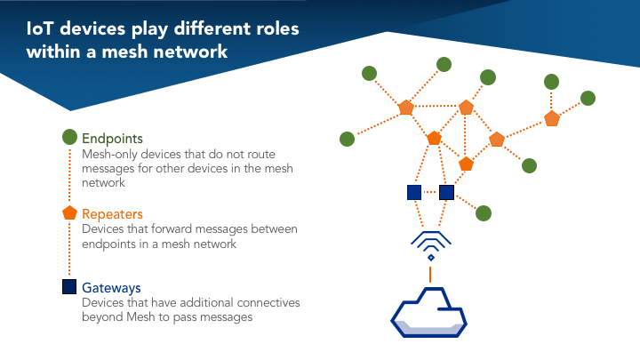
IOT - Communications

Slide 16
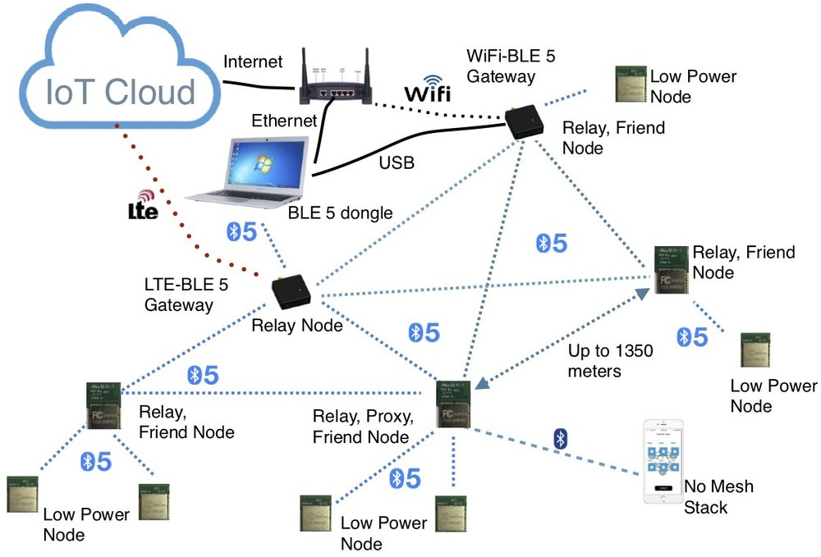
IOT - Communications
Mesh Networks

Slide 17
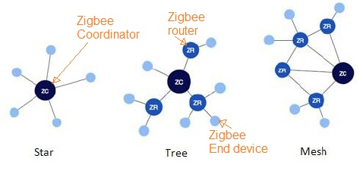
IOT - Communications
Mesh Networks

Slide 18
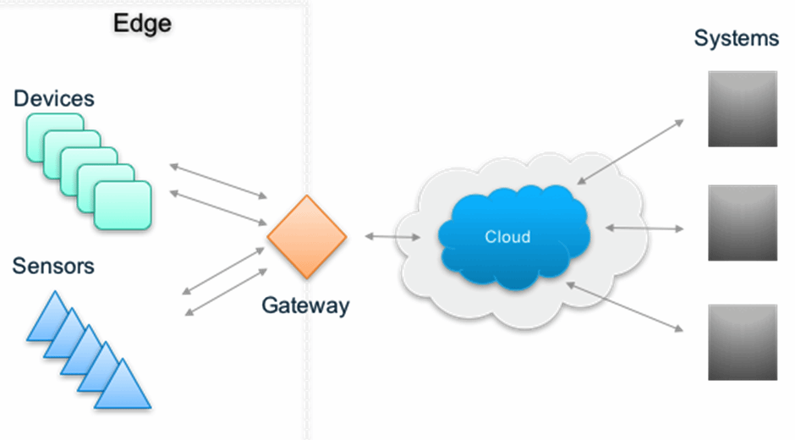
IOT - Communications
Gateway Devices

Slide 19
Wireless Communications Standards Gateway Link
Distance
Graphics
HiFi Audio
Digital
Video
Text
Internet
Video
streaming
Multi-channel
Video
100 km
802.16
WI-Max
10 km
GSM/CDMA
GPRS/3G
LMDS
WAN
1 km
802.11.a/b/g
Wi-Fi/HL
100 m
LAN
802.15.4
Zigbee, UWB
10 m
802.15.1
Bluetooth
802.15.3
UWB
PAN
1 m
BAN
10 kbits/s
100 kbits/s
1Mbits/s
10 Mbits/s
100 Mbits/s
Débit

Slide 20
IOT
Internet of Things
Devices that are always available and always connected
Power
Communications
Information

Slide 21
IOT
Internet of Things
Devices that are always available and always connected
What is the information that we receive from the sensor?
Simple Voltage
Packets of Data
Video

